Slide 1
Net Zero Land use options around Central Bedfordshire
Odette A, Adil Malik, A. Ebenezer, B. Godfred, D. Rajasekhar Reddy, Yen Ju Ho (I-ENV-GRPP1)
Supervisors: Michail Giannitsopoulos,
Paul Burgess, and Anil Graves
25 April 2023

Slide 2
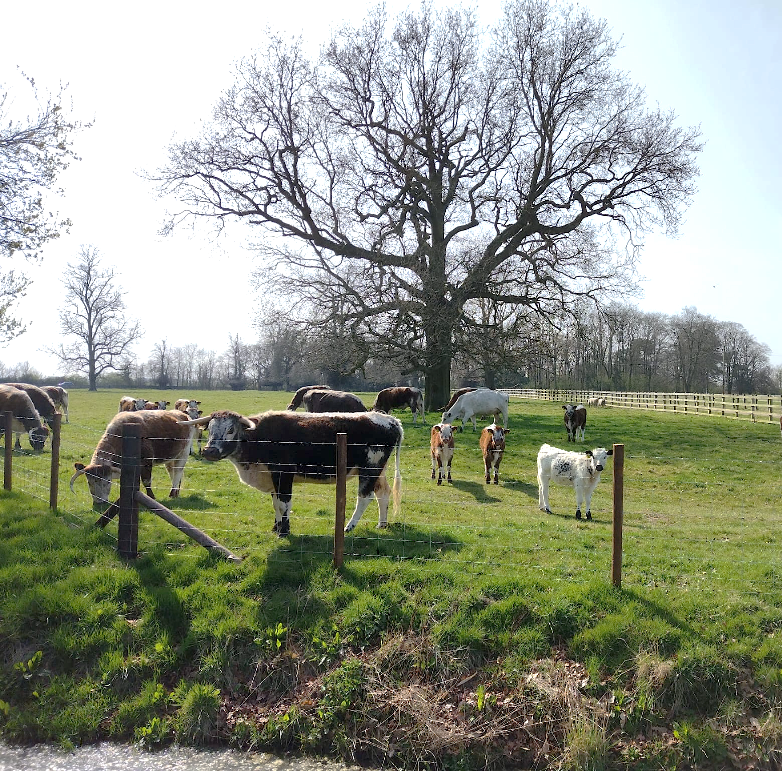
Outline
Introduction
Aim and Objectives
Land Cover
Farm Distribution
Baseline Calculation
Scenario – net zero modelling
Conclusion
Question

Slide 3
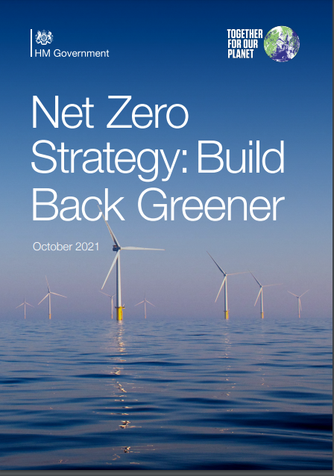
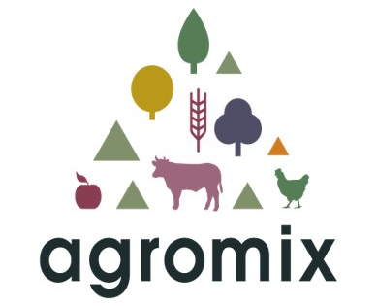

Introduction - Background
The UK has committed to achieve net-zero greenhouse gas (GHG) emissions by 2050 (UK Government, 2019).
UK’s agricultural sector produced about 10% of the UK’s total territorial GHG emissions in 2019 (UK Government, 2021).
National Farmers Union commits to achieve net-zero GHG emissions by 2040 (NFU, 2019).
As part of an EU project called Agromix, Cranfield is investigating the challenges faced by farmers and the role of trees on farms.
Images: UK net-zero strategy document, NFU logo and Agromix logo
Notes:
Farm Practices Survey indicated that 2/3 of farmers consider importance of GHG emissions in business decisions but possess limited knowledge on current levels of emissions (UK Government, 2021).
Cranfield University is a partner in the ‘AGROMIX’ European project, focussed on researching resilient and efficient land use methods.
A workshop in the Marston Vale identified farmers’ interest in understanding their current GHG balance and potential role of trees in supporting move to net-zero GHG emissions by 2040.

Slide 4
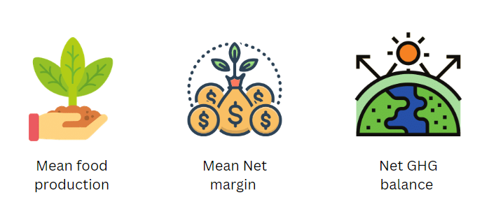
Introduction - Aim and objectives
Aim: To compare the effect on food production and profitability if each farm business achieves net-zero greenhouse gas emissions in the Marston Vale
Images: Mean food production, mean net margin and Net GHG balance.

Slide 5



Objectives
To determine the current land use in the Marston Vale
To determine the range of farm sizes and farm types in the Marston Vale and to spatially allocate representative farms in the Marston Vale.
To predict the mean level of food production for each modelled farm
To predict mean net margin for each modelled farm.
To predict mean current level of GHG emissions for each farm
To determine and compare the land use, productivity, and profitability implications of a scenario that achieves net zero for i) each farm, and ii) at the Marston Vale scale.
To discuss the implication of the study in terms of government and institutional arrangements
Productivity
Profitability
GHG
emission
Images: Farm level and Marston Vale level.

Slide 6
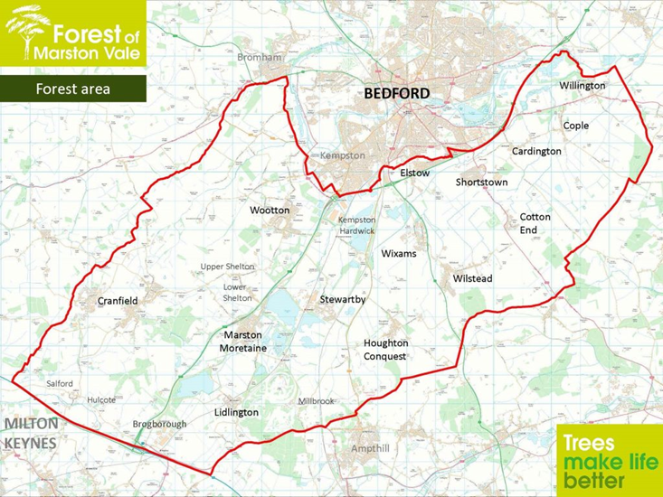
1. Characterize the study area
Marston Vale situated in Bedfordshire, with the northern part in Bedford Borough, and the southern part of the area in the Central Bedfordshire district. It has long history of agricultural production, with wheat, barley, oats, turnips, clover, and livestock farming.
Today, Agriculture still a vital part of the economic in Marston Vale area and starts focusing on transfer into more sustainable farm.
Figure 1. Marston Vale map (Forest of Marston Vale, 2022)

Slide 7
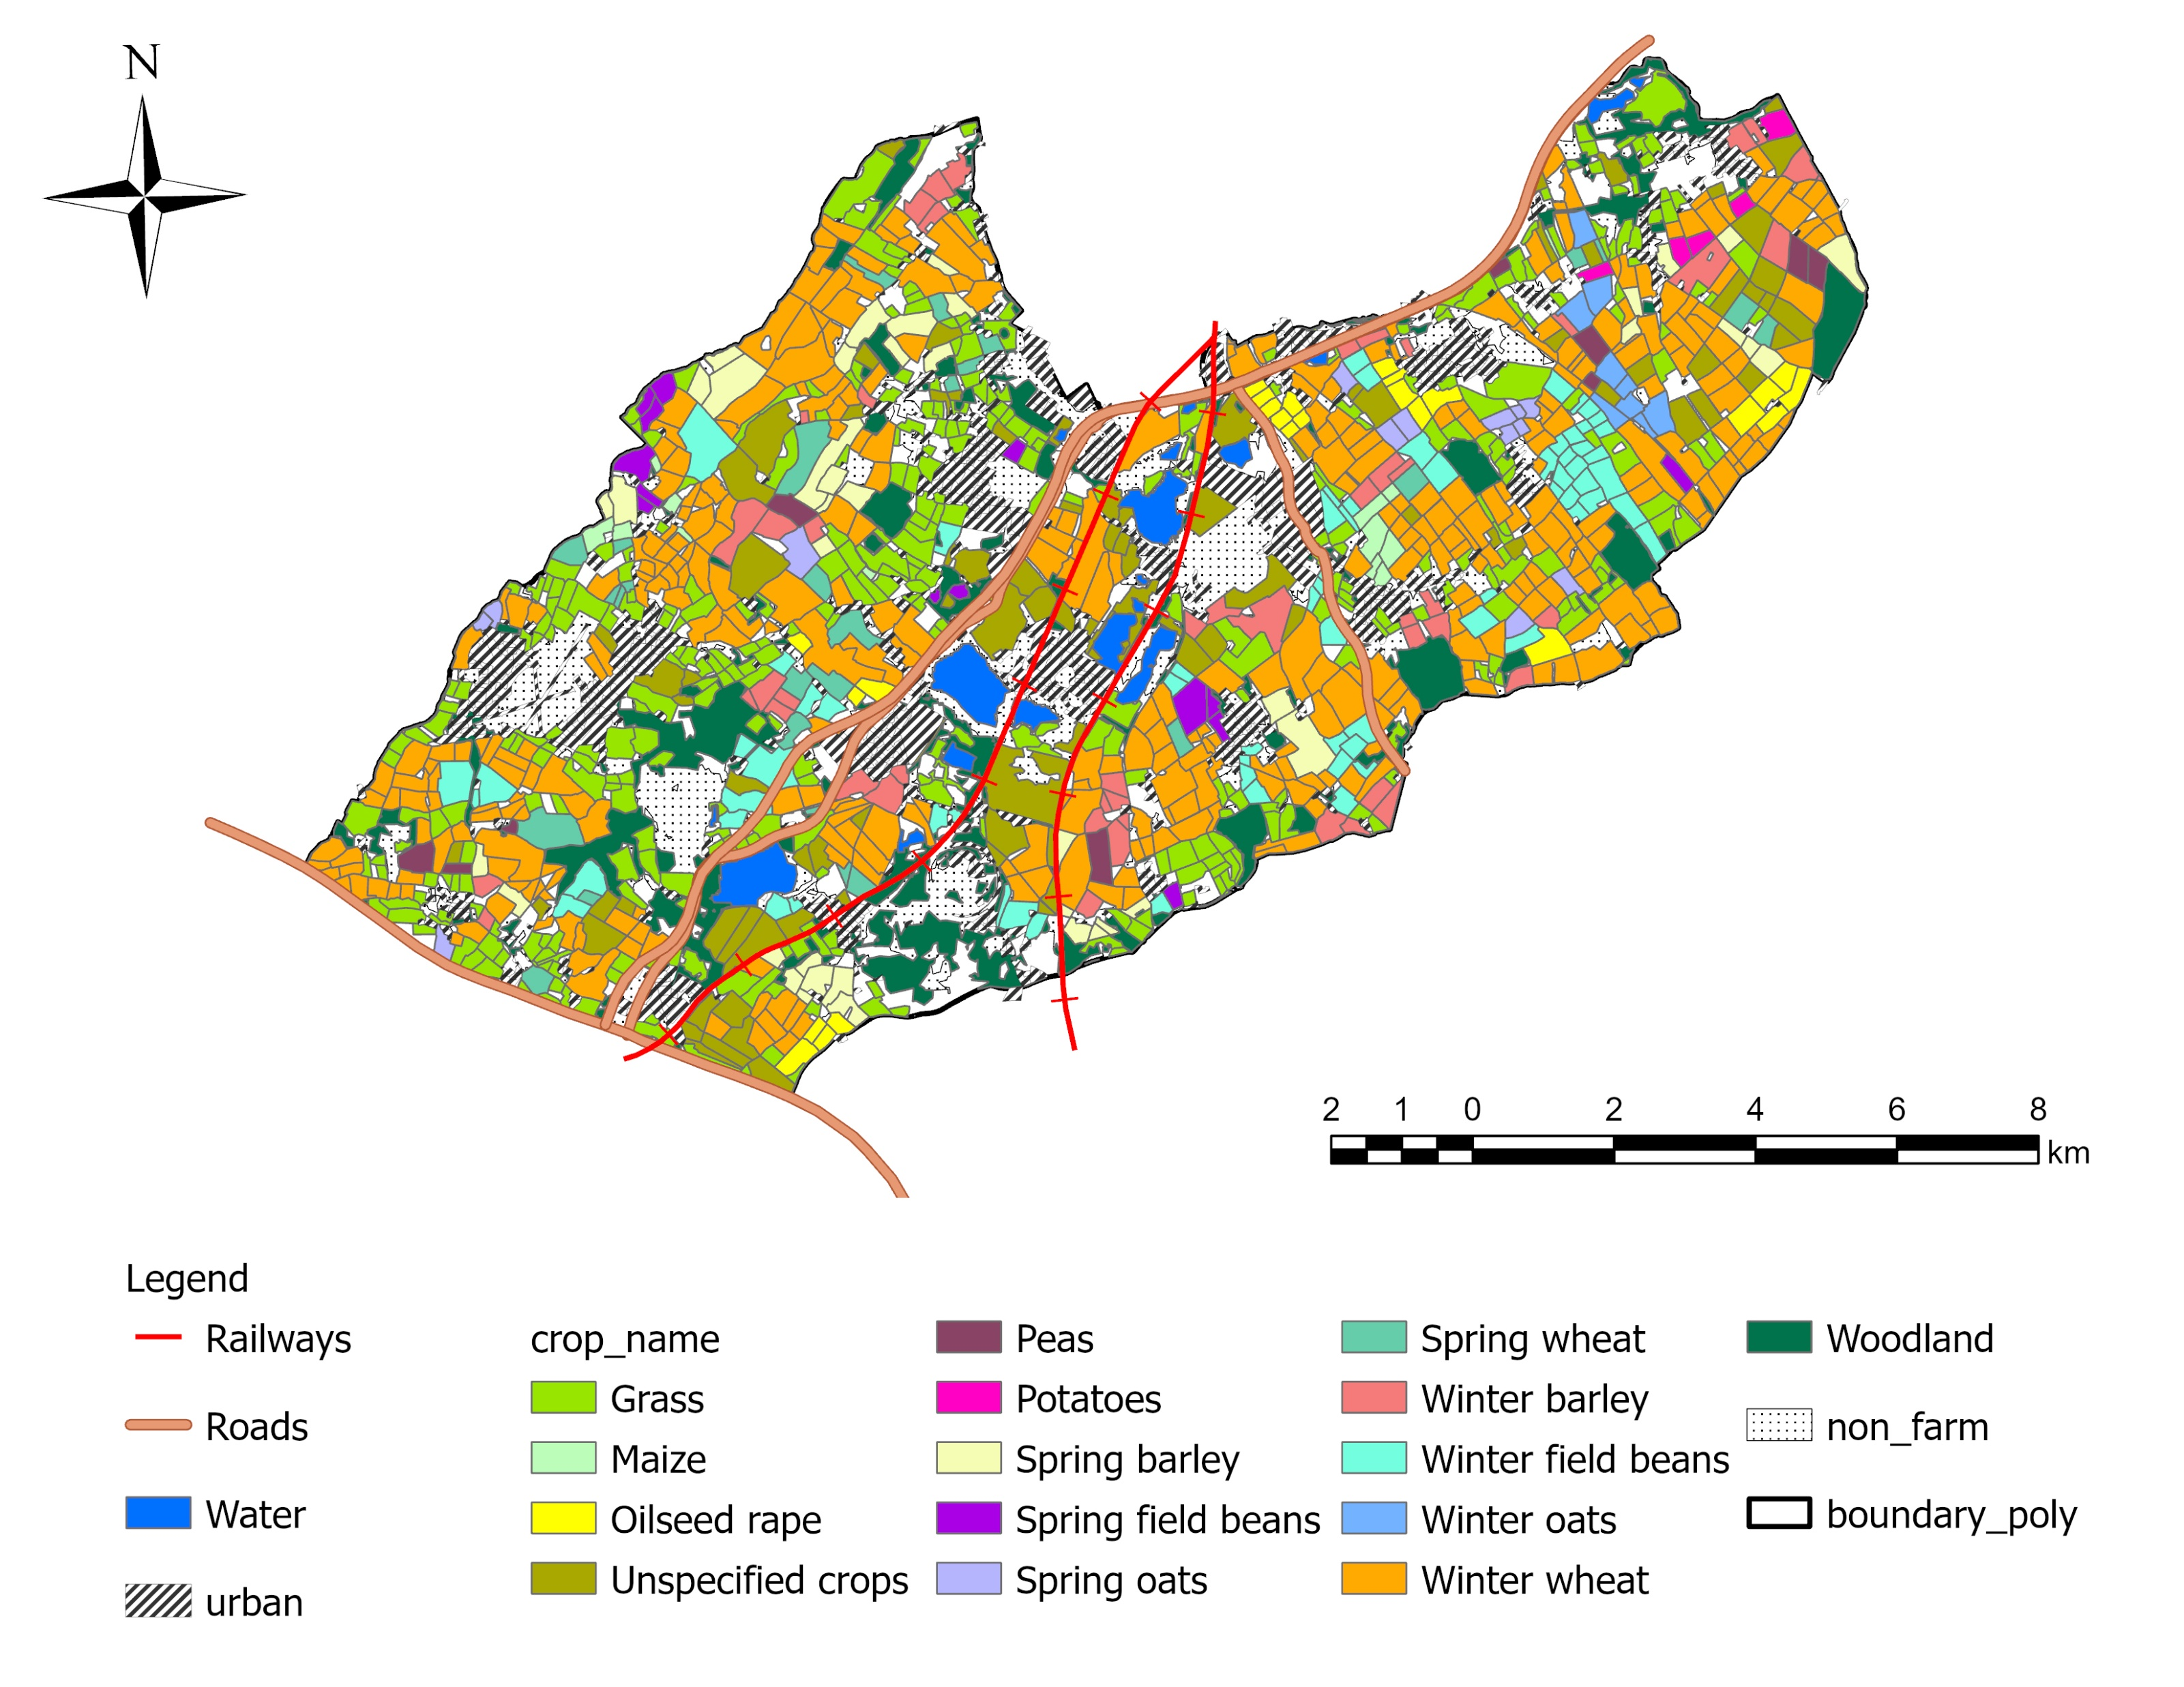
1. Characterise the study area
Method
Supervised image classification approach
Satellite imagery (Landsat 8 collection 2 level 2)
Principal arable crops:
Spring and winter wheat (4,228 ha), 26%
Spring and winter barley (1,028 ha) 6%
Winter field beans (652 ha) 4%
Oilseed rape (231 ha) 1%
Other land use:
Woodland (1,793 ha) 11%
Grassland (2,251 ha) 14%
Urban/built areas (3,704) 23%
Figure 2. Marston Vale land cover map 2022

Slide 8

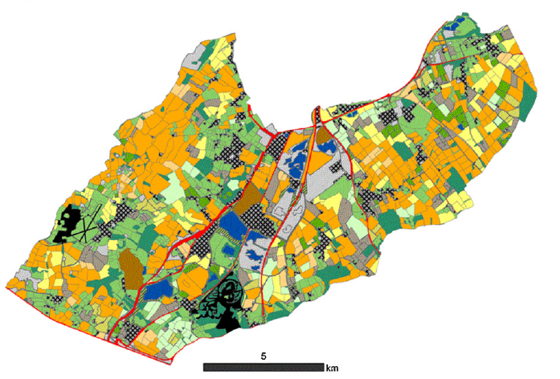
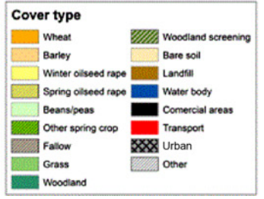
1. Characterise the study area
Figure 3. Land cover map 2009 (Burgess et al., 2012)
Figure 4. Marston Vale land cover map 2022

Slide 9
1. Characterize the area
Table 1. Land use comparison between 2009 and 2022
Land-use type | Area in 2009 (ha) | Area in 2022 (ha) | Change (ha)
Agricultural | 11,071 | 10,254 | -817
Woodland | 1,312 | 1,793 | +481
Built-up areas | 2,930 | 3,704 | +774
Grassland | 2,821 | 2,251 | -570
Figure 5. Changes in Land use from 2009 to 2022 in
Marston Vale

Slide 10
2. Determine range of farm sizes
The predicted farm size distribution for Marston Vale was derived from the farm size data for Central Bedfordshire and Bedford Borough (Defra June Survey, 2021)
Table 2. Farm size distribution of selected farms in Central Bedfordshire and Bedford Borough
 | Mean area (ha) | No of farm holdings | % holdings | % area
< 5 ha | 2.5 | 37 | 11 | 0.2
5 - 20 ha | 12.5 | 84 | 23 | 2.7
20 - 50 ha | 35.0 | 62 | 17 | 5.4
50 - 100 ha | 75.0 | 58 | 16 | 10.9
≥ 100 ha | 265.0 | 120 | 33 | 80.7
Total |  | 361

Slide 11
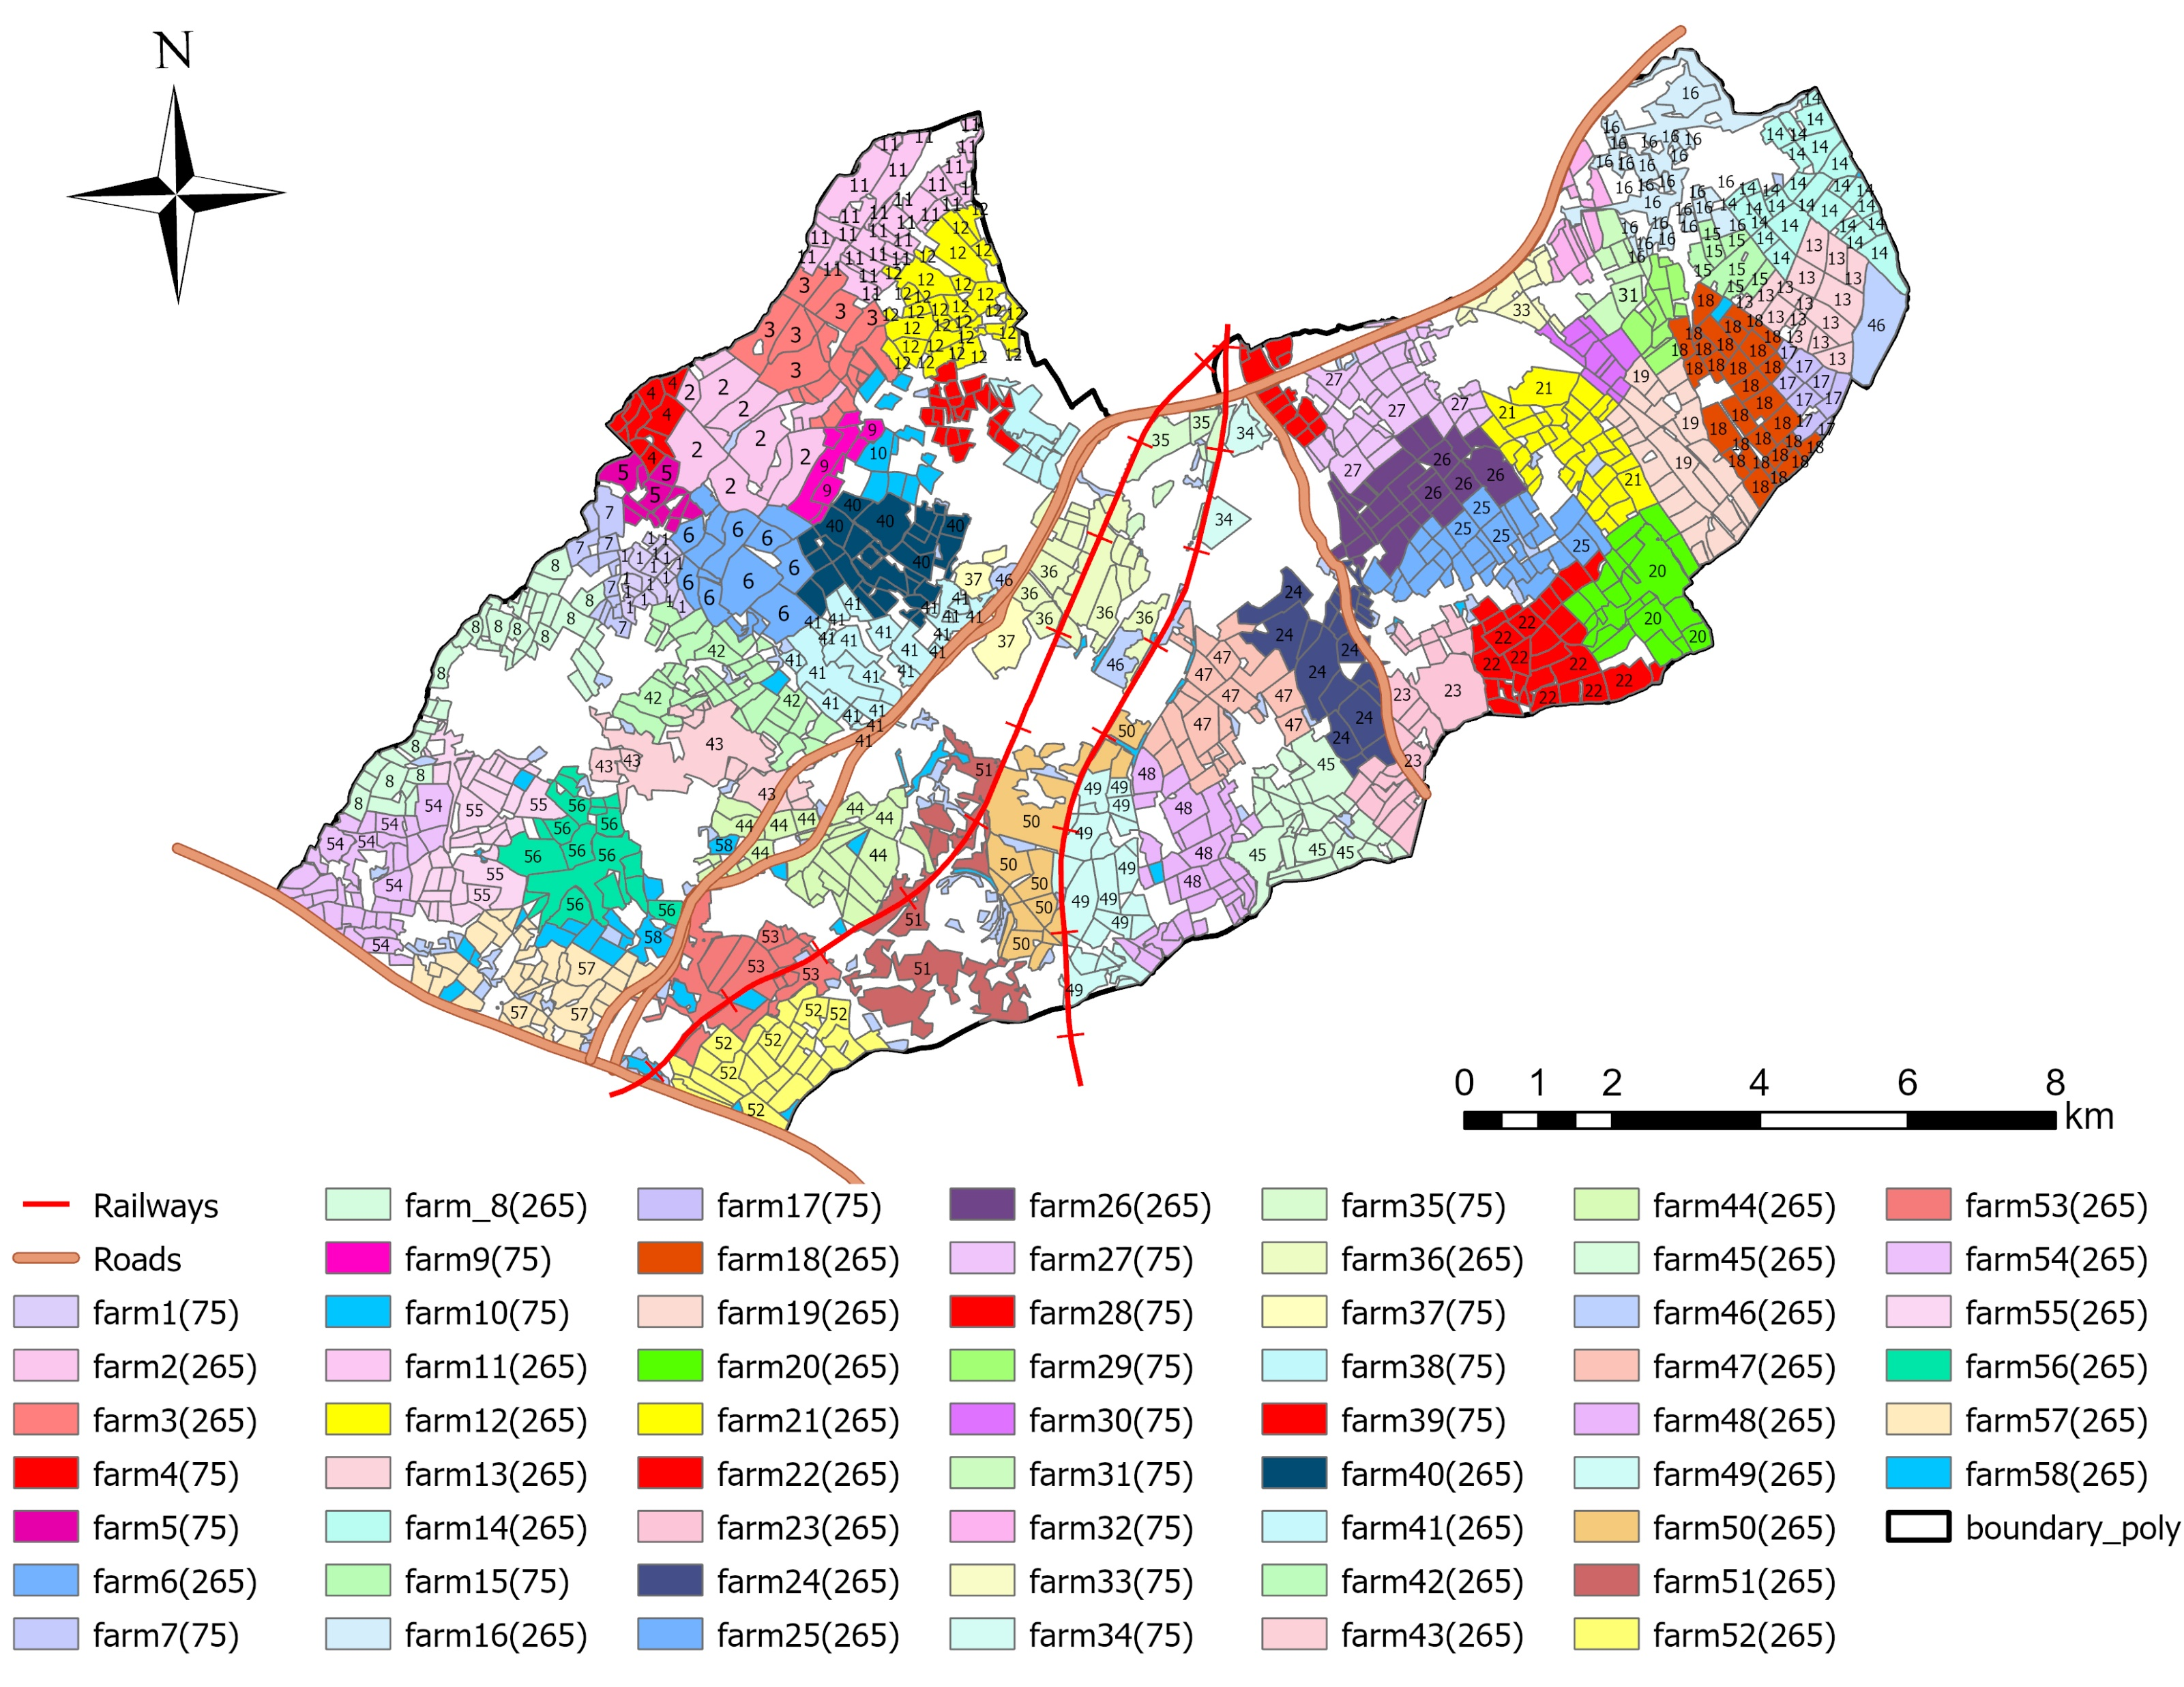
2. Determine range of farm sizes
Marston Vale was divided into 58 farms of either 75 ha or 265 ha
Table 3. Area distribution for Farm-scale
 | Mean area (ha) | Number of farms
50 – 100 ha | 75 | 19
≥ 100 ha | 265 | 39
Total |  | 58
Figure 6. Map showing representation of 58 farms

Slide 12
3. Food and wood production
Table 4.Land use “bioenergy” yields
Crop type | Yield (t/ha) | Yield (GJ/ha)
Wheat | 8.6 | 114
Barley | 7.3 | 92
Oilseed rape | 3.5 | 68
Other spring crops | 4.3 | 59
Woodland | 7.4 | 63
Grass | 8.4 | 49
Arable
Crop yields derived from Nix (2023).
Woodland
Biofuel yield derived from volume per ha for beech, oak, and sycamore species in Marston Value (UK Woodland Carbon Code 2021).
Grassland
Grass feed yields converted in meat production per hectare based on suckler cows and lowland ewes (Nix 2023)
Table 5. Grass land feed and food yield
Type | Carcass weight/yield (kg/ha/yr) | Yield (GJ/ha/yr)
Beef finishers | 215 | 1.9
Sheep | 129 | 1.1

Slide 13
3. Food and wood production
Table 6. Example levels of food and wood for selected farms
Farm | Area (ha) | Food production (GJ/ha/yr) | Wood production (GJ/ha/yr)
2 | 75 | 105 | 0
20 | 271 | 71 | 16
47 | 269 | 0 | 63
Figure 7. Food per farm
Figure 8. Wood per farm

Slide 14
4. Predict net margin
Table 7. Net margin calculation from Nix (2023).
Annual net margin = R – V – A,
where R is the crop & livestock revenue,
V is the variable costs and A is the assignable fixed costs derived
from Nix (2023).
Area payments are also derived from Nix (2023).
For woodland, equivalent annual value
is estimated based on timber volume per ha derived from UK Woodland Carbon Code (2021) and plantation & maintenance costs derived from Nix (2023).
Land use | Yield (t/ha) | Annual net margin without area payments (£/ha/yr) | Annual net margin with area payments (£/ha/yr)
Wheat | 8.6 | 885 | 1105
Barley | 7.3 | 605 | 825
Oilseed rape | 3.5 | 1079 | 1299
Oats | 6.1 | 509 | 729
Peas | 4 | 702 | 922
Potatoes | 50.4 | 6618 | 6838
Beans | 4.3 | 862 | 1082
Grassland (Livestock) | - | -458 | -237
Woodland | 7.4 | -49 | -250

Slide 15
4. Predict net margin
Table 8. Mean net margin at Farm scale
Farm | Area (ha) | Mean net margin (£ /ha/yr)
39 | 82 | -163
47 | 269 | -38
2 | 75 | 733
31 | 77 | 1187
5 | 78 | 2004
The level of profitability is highest for those farms producing potatoes and wheat
Around 14% of 58 farms currently have a negative mean net margin
Figure 9. Mean Net margin

Slide 16
5. Predict GHG emissions
Table 9. Net GHG emissions per arable crop
Crop type | Yield (t/ha) | GHG emissions (tCO₂e/ha/yr)
Wheat | 8.6 | 3.3
Barley | 7.3 | 2.4
Oilseed rape | 3.5 | 2.6
Oats | 6.1 | 1.9
Peas | 4 | 1.6
Potatoes | 50.4 | 11.1
Beans | 4.3 | 0.4
GHG emissions were calculated using farm to gate approach
Arable system:
GHG emission in tCO2e/tonne of yield for various crops are derived from Langfield & Foot (2022)
The emissions per tonne of yield is converted to emissions per hectare using Nix 2023 yield values
Grassland system:
Using the yield values obtained from mean food production with the footprint value of beef and Lamb per kg, livestock emissions are calculated in tCO₂e/ha/year (AHDB, 2021)
Emissions associated with Land use change and grass plantation are out for scope for this study
Table 10. GHG calculation of grassland
Type | Yield (kg/ha) | GHG emissions (tCO₂e/ha/yr)
Beef finisher | 215 | 5.1
Ewes | 129 | 3.2
Livestock total | - | 8.3

Slide 17
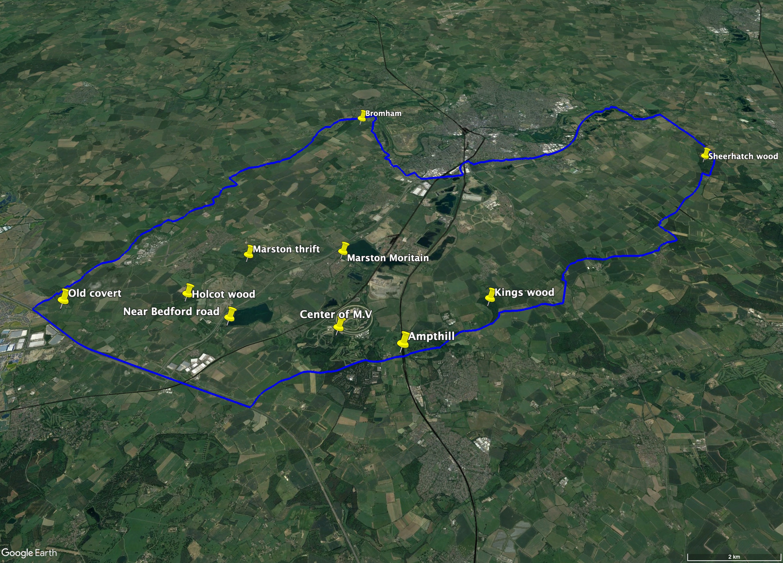
5. Predict carbon sequestration from woodland
Determine the representative yield class
Randomly selected ten locations on Forest Research web-based tool.
Ecological site classfication (tree species)
Table 11. Average of tree yield class
Tree species | SAB | Beech | Oak
Average yield class | 9.3 (10) | 5.4 (6) | 3.3 (4)
Figure 10. Sites for the yield class
Notes:
To estimate the carbon sequestration of woodland, we decide three tree species (), and we look into Forest research map.

Slide 18
5. Predict carbon sequestration by woodland
Graphs plotted with the mean annual value and current annual value against the year
Year 40 is chosen as that represents the year of intersection
Average Carbon sequestration at year 40 is found to be 10.6 (t CO₂e/ha/yr)
Figure 11. Predicted growth of Beech

Slide 19
5. Predict net GHG balance per farm
Table 12. Results of net GHG at Farm scale
Net balance ranges from a sequestration of
10.7 t CO₂/ha/yr to emissions of 5.8 t CO₂e/ha/yr
10 of the 58 modelled farms (17%) sequestered more carbon than they emit.
Farm
A
Farm | Net GHG(t CO₂e ha⁻¹ yr⁻¹)
47 | -10.7
20 | -0.0
49 | 1.0
10 | 5.8
0
Figure 12: Greenhouse gas emission

Slide 20
6. Predict woodland area needed to achieve net zero
Around 17% of farms are already carbon negative and achieved net zero in the baseline scenario.
Additional woodland to achieve net zero GHG emissions for remaining 47 farms was based on the following equation.
Where A_{tree} is the proportional woodland area, GHG_{woodland} is the mean carbon sequestration by woodland over 40 years, and GHG_{baseline} is the baseline GHG balance per farm
A_{tree} = -GHG_{baseline} /(GHG_{woodland} -GHG_{baseline})
Table 13. Additional wood land area needed to achieve net zero
 |  | Baseline |  |  | Net zero |  |  | Additional
Farm | Area (ha) | Arable area (ha) | Grassland area (ha) | Woodland area (ha) | Arable area (ha) | Grassland area (ha) | Woodland area (ha) | woodland area %
56 | 265 | 97 | 94 | 74 | 87 | 83 | 95 | 7.95
31 | 77 | 72 | 5 | 0 | 56 | 4 | 16.5 | 21.42
33 | 72 | 22 | 47 | 4 | 14 | 30 | 28.5 | 34.34
10 | 77 | 37 | 40 | 0 | 24 | 26 | 27.15 | 35.11

Slide 21
6. Predict woodland to achieve net zero
Figure 13. Woodland area change

Slide 22
6. Effect of achieving net zero on food and wood
Tables 14 & 15. Food and wood production change
 | Food production (GJ ha⁻¹ yr⁻¹) |  | Change (%)
Farm | Baseline | Net zero
26 | 66 | 59 | -9.6
49 | 86 | 77 | -9.9
56 | 56 | 50 | -10.7
10 | 82 | 53 | -35.1
33 | 64 | 41 | -35.6
 | Wood production (GJ ha⁻¹ yr⁻¹) |  | Change (%)
Farm | Baseline | Net zero
26 | 8.8 | 14.0 | +60
49 | 8.0 | 13.5 | +69
56 | 17.6 | 22.6 | +28
10 | 0 | 22.1 | -
33 | 3.2 | 24.2 | +657
Figure 14 &15. Food & wood production change (58 farms)

Slide 23
6. Effect of net zero on mean farm net margin
Table 16. Decrease in mean net margin to achieve net zero
Farm | Net margin (£/ha/yr) |  | Change (%)
 | Baseline | Net zero
26 | 501 | 444 | -11
49 | 622 | 551 | -11
56 | 149 | 122 | -18
10 | 190 | 100 | -47
33 | -43 | -52 | -20
Figure 16: Mean net margin change

Slide 24
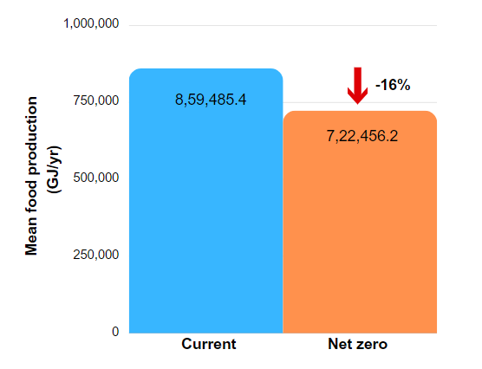
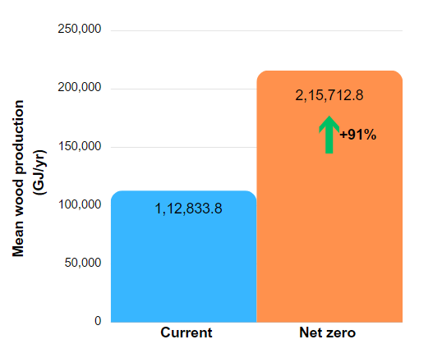
6. Predict effect of achieving net zero at Marston Vale scale
Marston Vale level is calculated with the land area results along with the benchmark values for emissions and Yield values from Nix,2023 for more accurate modelling.
16% of arable and grassland area to be converted into woodland for net zero (total 1634 ha).
Food production is decreased by 18% while wood production has almost doubled
Figure 17 & 18 : Marston Vale level mean food & wood production change (current vs Net Zero)

Slide 25
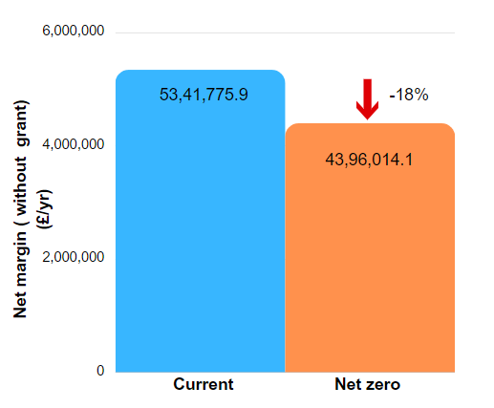
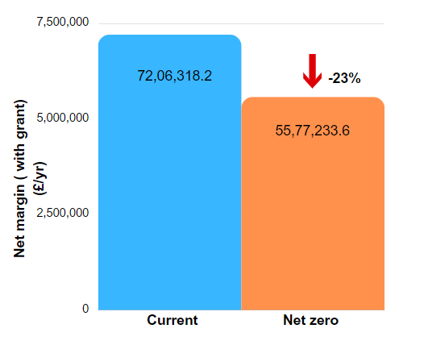
6. Predict effect of achieving net zero at Marston Vale scale
Net margin without grant has decreased by 18% at Marston Vale scale .
Current grant system do not make a huge difference to profitability
Figure 19 & 20 : Marston Vale level mean margin change (with & without grants) (current vs Net Zero)

Slide 26
7. Conclusions
The requirements for woodland can be reduced by reducing production emissions
Livestock production GHG emissions were high per hectare. Enteric methane can be reduced through feed optimization
Emissions from arable crops can be reduced through improved fertilizer use and less pollution machinery.
Increased carbon sequestration from woodland can achieve net zero by “insetting” for a period of about 40 years after planting.
Carbon sequestration could also be increased through reduced tillage and incorporating high carbon organic materials.
The height and width of hedgerows can also be increased, potentially providing additional benefits for biodiversity and soil conservation.

Slide 27
7. Conclusions
Assessment of agricultural land. ( New woodland, parkland) (CBC, 2021)
Specific organisation to support farmers about transition.
Various strategies of planting trees such as shelterbelt, spinneys and coppes. (BBC, 2022)
Combination between new development in urban area and green infrastructures. (BBC, 2022)
Cooperation with business for the grants or benefits to support actions. (NFU, 2019)

Slide 28
8. Summary : Our Actions
Updated the landcover Map by using satelite imagine to determine the landcover of Marston Vale in 2022.
Analysed farm size, number of farms and owners in Central Bedfordshire and Bedford Borough contributed to build the baseline caculation with 58 farms' breakdown.
Calculated the mean food production, mean net margin and green house gas emission calculator for three classification ( arable, grassland and woodland ) to estimate productivity and profitibility at the farm scale.
Gave assumptions to achieve Net zero on i) farm ii) Marston Vale scale based on the Net zero modelling established.
Discussed the results and offered the recommendation to achieve Net zero goal with the policy literature review.

Slide 29
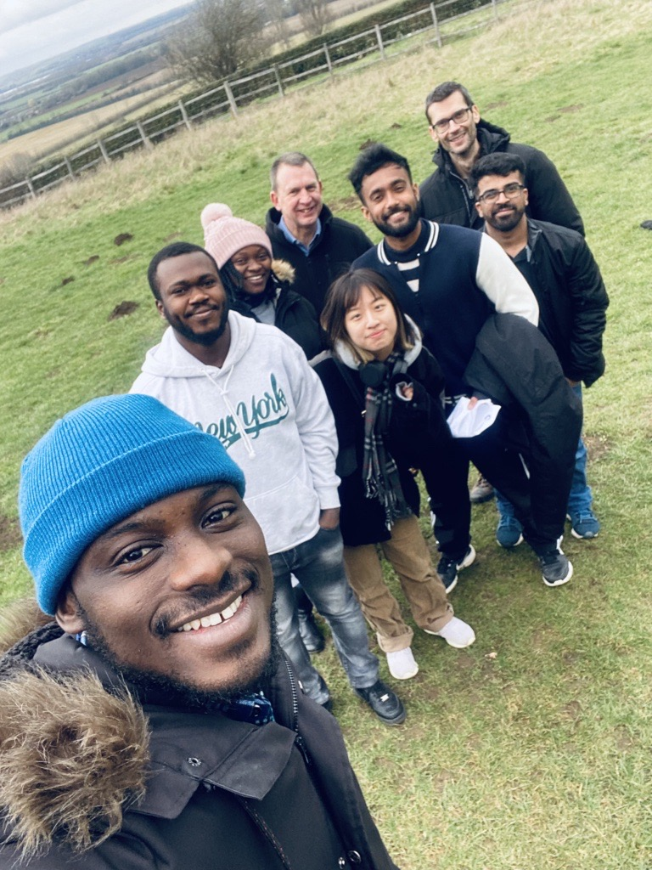
Thank You
Questions?

Slide 30
References
Agriculture and Horticulture Development Board (AHDB), 2021. Carbon footprints: food and farming. Available at https://ahdb.org.uk/knowledge-library/carbon-footprints-food-and-farming
Burgess, P.J., Rivas-Casado,M., Gavu, J., Mead, M., Cockerill, T., Lord, R., van der Horst, D., & Howard, D.C. (2012) A franework for reviewing the trade-offs between renewable energy, food, feed and wood production at local level. Renewable and Sustainable Energy Reviews 16:129-142
Burgess P J (2021) Predicted Carbon Sequestration Rates of Broadleaf Woodland in South East England. Bedfordshire: Cranfield University. 18pp.
Bedfordshire Council, C. (2021). Central Bedfordshire Local Plan (2015-2035). https://www.centralbedfordshire.gov.uk/info/153/central_bedfordshire_local_plan_2015_to_2035/1034/adopted_local_plan
Bedford Borough Council ,(2022). Developing in the Forest of Marston Vale: Design Guidance Supplementary Planning Document (SPD). https://www.bedford.gov.uk/planning-and-building-control/planning-policy/forest-marston-vale-development-design-guidance
Code, W. C. (2021). Woodland carbon code: Requirements for voluntary carbon sequestration projects.
DEFRA (Department for Environment, Food and Rural Affairs). Regional structure of farm sizes in England - A report on the 2021 Survey. Accessed 15 April 2022 at
http://www.defra.gov.uk/statistics/files/defra-stats-food-family-annual-2008.pdf

Slide 31
References
Farm credit of Virginias, (n.d.). From birth to steak. Available at From birth to steak (farmcreditofvirginias.com)
Jones, A., Kong, A.T., Chiepa, B., Baptista De Lima, K., Fuentes, M., Kesha, M. (2022). Greenhouse gas balance of contrasting farms and the role of trees. Draft Group Project Report. (Supervisors: Burgess, P.J., Graves, A. Cranfield University).
Langfield, H., Foot, J., (2022). Benchmarking greenhouse gas emissions for the UK arable and horticultural sector. Available at CHAP_Net_Zero_Report_0822.pdf (chap-solutions.co.uk)
Marston Vale Trust (2000). The Forest of Marston Vale - Forest Plan 2000.
National Farmers Union (2019). Achieving Net Zero: Farming’s 2040 goal.
Nix, J. and Reddman, G. (2022). John Nix pocketbook for farm management: 52 Edition.
UK Government (2019). UK becomes first major economy to pass net zero emissions law - GOV.UK. Available at: https://www.gov.uk/government/news/uk-becomes-first-major-economy-to-pass-net-zero-emissions-law [Accessed on: 8th April 2022].
UK Government (2021). Agri-Climate Report 2021. Available at: https://www.gov.uk/government/statistics/agri-climate-report-2021/agri-climate-report-2021 [ Accessed on 8th April 2022].

